Slide 1
BUDGET SALES ANALYTICS
DETAILED PROJECT REPORT

Slide 2
Project Details
Project Title | Budget Sales Analytics
Technologies | Data Science
Domain | Retail & Sales
Difficulties Level | Advanced
Tools Used | Power BI

Slide 3
Problem Statement
Extract various information such as Sales, budget, and variance. You can even compare sales and budgets with various attributes. Extract necessary information about Products and Customers. Make the necessary dashboard with the best you can extract from the data

Slide 4

Architecture
Data Collection
Importing dataset in Power BI
Load Dataset
Real world
Insights
Creating Dashboards
Data Modelling
Reporting

Slide 5
Dataset Information
Budget Data: Category , Sub Category , Product Name , Budget from January 2016 to December 2016
Adventure Works _ Database:
Calendar :
Territory:
Sales:
Date | Date key | Year | Quarter | Month Num | Month | Fiscal Year | Fiscal Quarter
Fiscal Month Num | Fiscal Month | Month Year | Month Year long | Month Year Num | Week day Num | Week day | Week day Weekend
Sales Territory Key | Region | Country | Group | Regionimage
Product key | OrderDate | ShipDate | Customer Key | Promotion Key | Sales Territory key
SalesOrderNumber | SalesOrderLineNumber | OrderQuantity | UnitPrice | TotalProductCost | SalesAmount

Slide 6
Product:
Customers:
ProductKey | Product Name | Sub Category | Category | Standard Cost | Color | ListPrice
Days To Manufacture | ProductLine | Model Name | Photo | Product Description | StartDate
Customer Key | First Name | Last Name | Full Name | Birth Date | Marital Status | Gender
Yearly Income | Total Children | No of Children at Home | Education | Occupation | House Owner flag | Number of cars owned
AddressLine1 | Date First purchase | Commute Distance

Slide 7
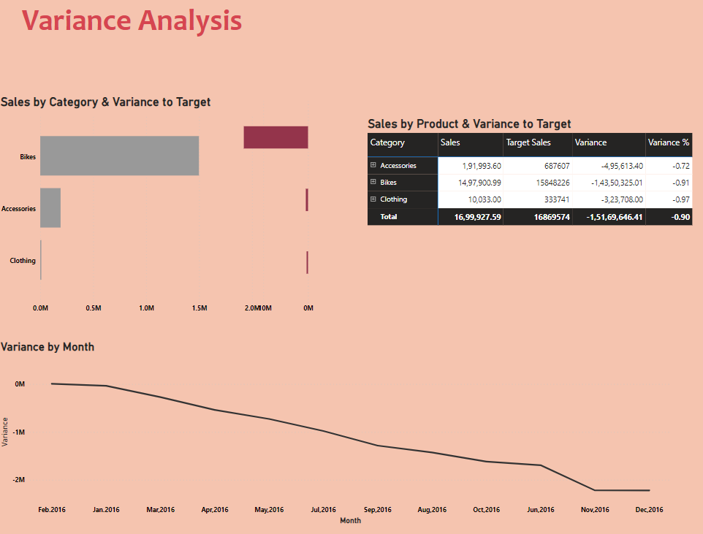
INSIGHTS
All categories is showing a
negative variance which
indicates low performance
compared to budget.
Bike category shows the lowest
performance in sales
We can see that variance becomes
more and more negative through
months.

Slide 8
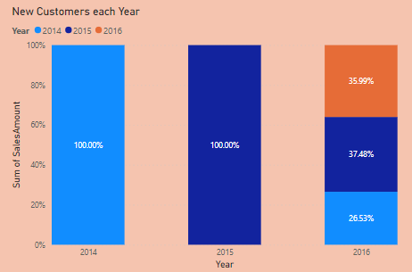
We can see that in 2014 and 2015 we have 100% new customers whereas in 2016 we have 26.53% customers
from 2014, 37.48% from 2015 and 35.99% new customers.

Slide 9
KEY PERFORMANCE INDICATOR
Profit in different years
Sales in different years
Quantity Ordered in different years
Total Cost in different years
Profit Margin
Revenue and Profit by Subcategory
Revenue and profit by Product line
Total revenue by month and country
Total profit by month and country
Sales by category and Variance to target
Sales by Product and Variance to Target
Variance by Month
New Customers each year
Total Customers by country
Customers and their revenue and profit contribution

Slide 10
CONCLUSION
Most of our customers are from United States
We have completely new customers for the year 2015 and 2014. For 2016 we have 35.99% new customers.37.48% of the customers in 2016 comes from 2015 and 26.53% from 2014
Our total Revenue for the three years is 2,93,07,836.59 Rupees (29.31 M)
Our total Profit is 22,34,355.98 Rupees(2.23M)
Total Ordered Quantity is 91321
Total cost is 27.07 M
Sales and Profit Analysis for 2014:
Total Revenue: 7.07 M
Total Profit: 436.26K
Total Cost: 6.64 M
Total Ordered Quantity:3492
Profit Margin: 6.17%
Sales and Profit Analysis for 2015:
Total Revenue: 5.76 M
Total Profit: 561.15K
Total Cost: 5.20 M
Total Ordered Quantity:4945
Profit Margin: 9.74%

Slide 11
Sales and Profit Analysis for 2016:
Total Revenue: 16.47 M
Total Profit: 1.24M
Total Cost: 15.24 M
Total Ordered Quantity:83K
Profit Margin: 7.51%
Variance Analysis :
All categories is showing a
negative variance which
indicates low performance
compared to budget.
Bike category shows the lowest
performance in sales
We can see that variance becomes
more and more negative through
months.

Slide 12
THANK YOU

